Slide 1
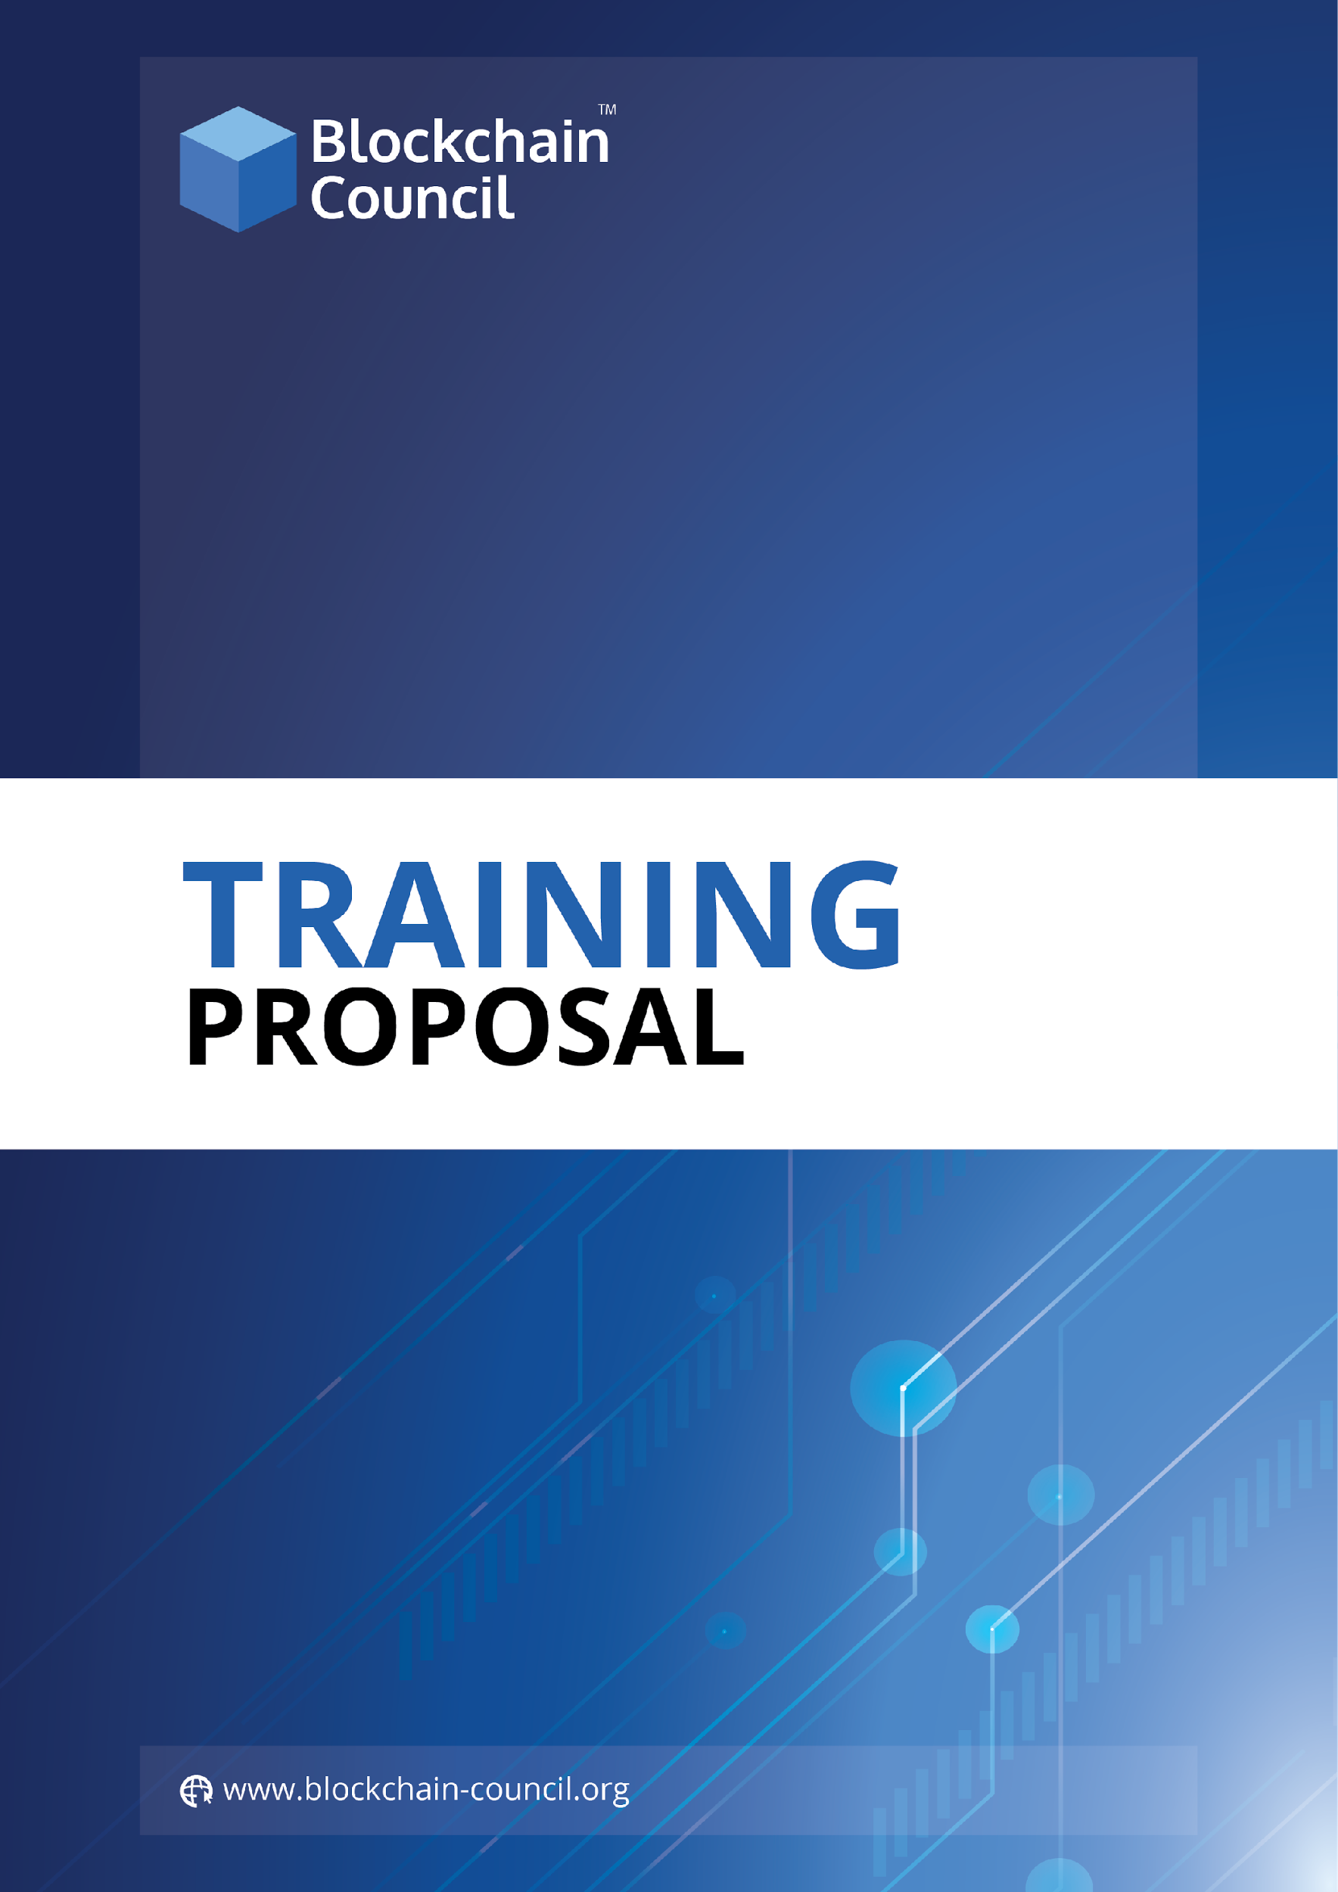

Slide 2
Overview
Blockchain Technology is more than a technology which is emerging rapidly and has a vast scope in the near future. Blockchain acts as a financial network, software, distributed ledger, etc. in multiple ways. Owing to this multitude of benefits and features, plethora of companies are now shifting from a centralized and traditional working systems to this trending and futuristic technology, “Blockchain”.
Blockchain Council creates an environment and raises awareness among businesses, enterprises, developers, and society by educating them in the Blockchain space. We are a private de-facto organization working individually and proliferating Blockchain Technology globally.
Blockchain Council is an authoritative group of subject experts and enthusiasts who are evangelizing the Blockchain Research and Development, Use Cases and Products, along with the knowledge required for a better world.
Blockchain Instructors
Toshendra Sharma ( Founder & CEO )
A Blockchain Researcher, Developer & Consultant. Founded Allchains, Blockchain-as-a-Service Company. He earlier founded SaaS-based mobile application security company Wegilant (Appvigil). He is very passionate about new technologies like Blockchain, IOT, Application Security, AI, etc. He has been featured in Forbes 30 Under 30 list of 2016, in Technology.
He is a well-known instructor & speaker in the Blockchain space and has taught over 12,000 students spread in 148+ countries.
Rohendra Singh ( CTO )
Programmer, Technologist, Developed SaaS based scalable products & led a tech team of over 20 people. Ex-VP Engineering at Wegilant (Appvigil).

Slide 3
About CBE Certification
The Certified Blockchain Expert is a skilled professional who understands and knows in-depth about Blockchain, its working and uses the same knowledge to build Blockchain-based applications for enterprises and businesses. The CBE credential certifies individuals in the Blockchain discipline of Distributed Ledger Technology from a vendor-neutral perspective.
Certified Blockchain Expert is an exhaustive training, lab & exam based program aiming to provide with proof of knowledge of the certificate holder in Blockchain space. The technology is evolving rapidly & enabling businesses to build compelling solutions at a lesser cost. Enterprises are struggling to identify the right talent to deploy on the in-house Blockchain-based projects.
The Objectives of CBE Credentials are
To establish and govern minimum standards for credentialing professional Blockchain expert , as it specializes in enterprise development measures.
To inform the public that credentialed individuals meet or exceed the minimum standards.
To reinforce Blockchain expertise as a unique and self-regulating profession.
Who can go for this course?
All students who are keen to learn about Blockchain Technology and their use-cases.
10+2 students from all the streams can go for this training and certification.
Why students should go for our Blockchain Certification?
Awareness about the latest technology.
Career opportunities in the future.
Can develop Blockchain based applications.
It can increase their potential in getting hired easily in the near future.
Undertake Internships on Blockchain based projects.
Certified students names will be displayed on our website.
Can attach their certified badge on various social media platforms like LinkedIn.

Slide 4
Benefits to the students after doing our Blockchain Certification
Free access to all the webinars conducted by The Blockchain Council
Discount on all the Blockchain study materials provided, such as E-books.
Free access to email training.
Lifetime access to the certification training.
Lifetime validity of the certificate issued by the Blockchain Council.
Benefits to the institution
Three members of the organization will receive free training and certification.
One year of free access to the council membership.
Email training
Names of Certified members will be displayed on our website.
Requirements
Basic knowledge of Computer
Must be motivated enough to learn Blockchain in-depth.
Duration
3-4 Hours of self-placed online training
1 hour for the exam
Training can be consumed as per candidate’s availability & speed.
Venue
Online Training and Exam
Training can be taken remotely
Examination
An online multiple choice exam of 100 marks followed by training.
You need to acquire 60+ marks to clear the exam.
If you fail, you can retake the exam after one day.
You’re given only 3 attempts to clear the exam.
If you failed to acquire 60+ marks, Blockchain Council will provide you an extra attempts and assistance to clear the exam.

Slide 5
Course Syllabus
On a broader level, you will be attending the training which will cover /the/ following topics:
Introduction
What is Blockchain in real life?
Why is Blockchain better than traditional technologies?
Benefits of using Blockchain Technology
Provenance
Consensus
Security
High Availability
Finality
Immutability
Bitcoin & Blockchain: What is the relation?
Ethereum & Smart Contracts
Private vs Public Blockchain
Why is it called a P2P network?
Sample Transaction: How transaction gets executed & distributed?
Consensus: How conflicts are being resolved?
When to Use a Blockchain & when not?
What is Blockchain mining?
What are Miners? What does a Miner do?
Security: Why Blockchain is More Secure
Attacks: How Blockchain Can Be Hacked
Private Blockchain: Can I setup my Own Blockchain
What are Some Different Blockchain Technologies?
Ethereum
MultiChain
Hyperledger
Stratis, etc.
Blockchain-as-a-Service
Microsoft Azure
IBM Bluemix
Use Cases: Supply-chain
Vendor Payment
Inventory Management
Asset Tracking
Regulatory Audit & Security

Slide 6
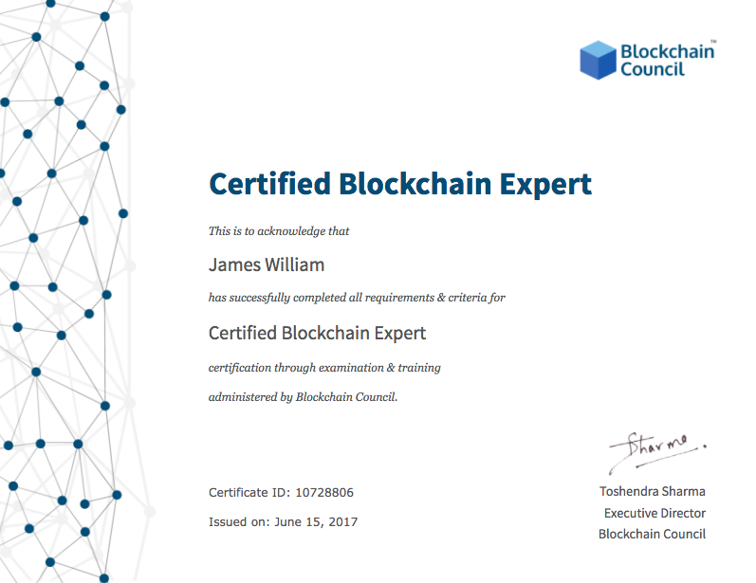
Use Cases: Manufacturing
Raw Material Tracking
Invoice & Receipt Management
Production Tracking
Regulatory Audit & Security
Use Cases: Healthcare Record Keeping
Health Record Management
Hospital Supply Tracking & Tracing
Faster Claim Settlement
Administrative & Regulatory Audit
Equipment tracking
Clinical Trials Record Keeping
Use Cases: Music & Entertainment Industry
Proof-of-Existence
Digital Copyright
Proof-of-Ownership
Sample Certificate

Slide 7
Commercials:
Online Training
Online training contains recorded training sessions of Instructors. In one-long stretch, a student can complete the course in 3-4 hours.
Cost – INR 6435/
100+enrollments (10% to the institute)
200+enrollments(20% to the institute)
500+enrolments(35%to the institute)

